Slide 1






CONFLUENTIA’25
Home
Tech Stack
Problem
Approach
CACHE_ME_IF_YOU_CAN
SAKSHAM AGRAWAL
ROHIT KUMAR
PS -5
BY
FOXO
HEALTH REPORT ANALYSIS & INSIGHT ENGINE

Slide 2
PROBLEM
Home
Tech Stack
Problem
Approach
Challenge: Medical reports, like blood tests, are filled with critical data about your health, but they are often complex and difficult for the average person to understand. This creates a barrier to proactive health management.
Gap: People are left with important questions: "What do these numbers mean?", "Are my levels normal?", and "What should I do next?". This uncertainty can lead to anxiety and missed opportunities for early intervention.
Need: There is a clear need for a tool that can translate complex medical data into simple, personalized, and actionable insights, empowering individuals to take control of their health.

Slide 3
INSIGHTS
Home
Tech Stack
Problem
Approach
The primary problem isn't a lack of data, but a lack of clear interpretation. For the most critical insights, complex machine learning is not required.
Rule Base Analysis :- A Rule-Based System offers a transparent, reliable, and highly effective solution. By defining clear, medically-backed rules (e.g., "If Total Cholesterol > 200 mg/dL, then status is 'Borderline High'"), we can automate the analysis instantly.
Why This Approach?
Transparent & Auditable: The logic is straightforward and easy to verify.
Maintainable: Medical rules can be updated in a central database without changing the application's code.
Fast & Efficient: It directly addresses the user's need for immediate interpretation without the overhead of ML models.

Slide 4
OUR SOLUTION
Home
Tech Stack
Problem
Approach
A secure MERN stack application that transforms raw health reports into clear, actionable insights.
How It Works:
Secure Upload & Login: Users sign in with their Google account via Passport.js and upload health reports in XLSX/CSV, or JSON format as well as manual biomarker entry.
Intelligent Parsing: The backend automatically extracts key biomarker data from the files.
Rule-Based Analysis: Our core json-rules-engine evaluates the data against a comprehensive set of rules stored in MongoDB, personalized for the user's age and sex.
Insightful Dashboard: The results are presented on a clean, interactive React dashboard featuring:
At-a-glance status of key diseases with biomarker level (e.g., Normal, High).
Simple, actionable recommendations in plain language.

Slide 5
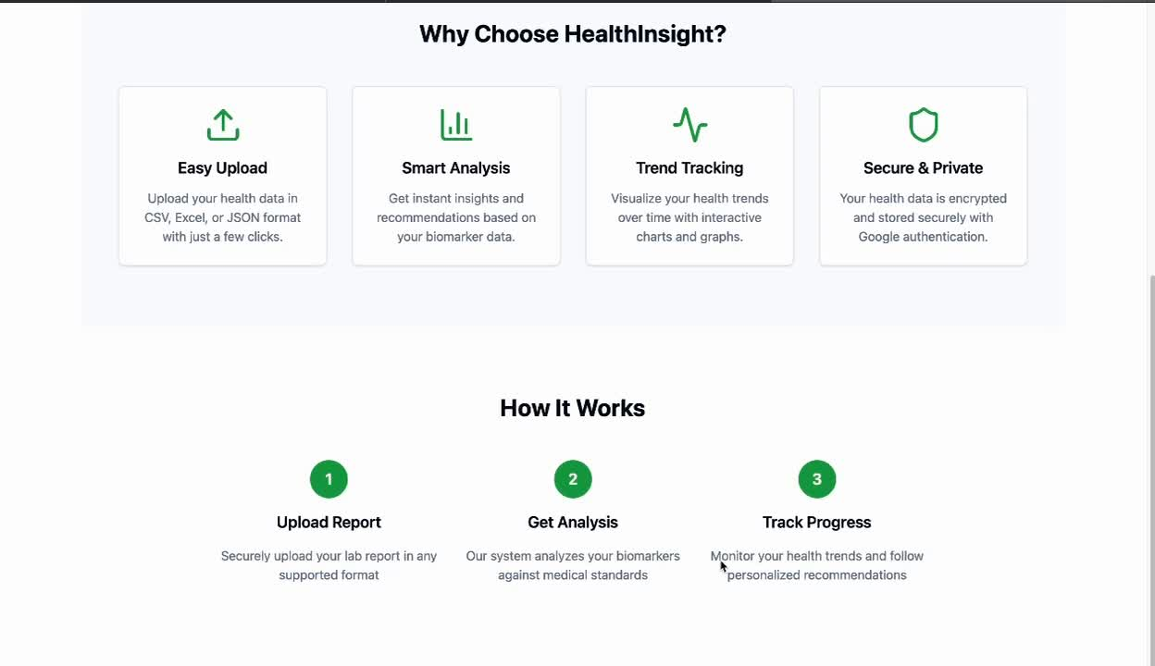
DEMO
Home
Tech Stack
Problem
Approach

Slide 6
NEXT STEPS
Home
Tech Stack
Problem
Approach
Enhance PDF Parsing:
Add rule-based PDF parser to handle a wider variety of unstructured and complex lab report layouts.
Integrate Optical Character Recognition (OCR) capabilities to support scanned documents and images, not just text-based PDFs.
Introduce Custom Machine Learning Models:
Goal: Move beyond static thresholds to provide predictive insights on potential health risks.
Implementation: Develop a custom ML model to analyze longitudinal biomarker data (trends over time) and identify subtle patterns that may indicate an elevated risk for conditions like cardiovascular disease or diabetes.
Implications: This would offer more sophisticated, proactive health guidance. However, it requires a large, anonymized dataset for training and rigorous validation to ensure accuracy and avoid bias. Explainability of the model's predictions would be a critical focus.

Slide 7
SUBMISSIONS
Home
Tech Stack
Problem
Approach
GITHUB REPO
https://github.com/sksmagr23/saic_hackathon_frontend
https://github.com/r120dhiman/saic_hackathon_backend
DEPLOYED LINKS
Frontend:- https://saic-hackathon-frontend.vercel.app/
Backend:- https://saic-hackathon-backend.onrender.com

Slide 8
CACHE_ME_IF_YOU_CAN
Home
Tech Stack
Problem
Approach
THANK YOU

